Slide 1
Employee Data Analysis using Excel
STUDENT NAME:N.Anitha
REGISTER NO:312216502 autunm1647cv1221647002
DEPARTMENT:B.Com(Bank management)
COLLEGER.B.Gothi jain college for Women

Slide 2
PROJECT TITLE
Employee Performance Analysis using Excel

Slide 3


AGENDA
Problem Statement
Project Overview
End Users
Our Solution and Proposition
Dataset Description
Modelling Approach
Results and Discussion
Conclusion
3/21/2024 Annual Review

Slide 4

PROBLEM STATEMENT
Employees performance analysis Using excel involves evaluating and measuring an Employees work Effectiveness and efficiency based on key performance Indicator (kpi). This data is then analysed using excels Functions and tools such as pivot tables ,chats, and conditional formatting, to identify.

Slide 5
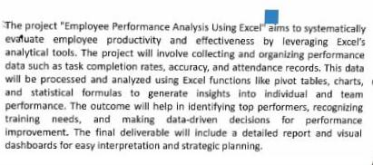

PROJECT OVERVIEW
.

Slide 6
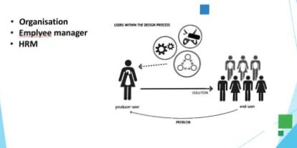

WHO ARE THE END USERS?

Slide 7

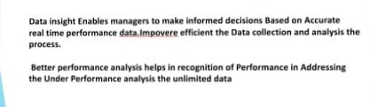
OUR SOLUTION AND ITS VALUE PROPOSITION

Slide 8
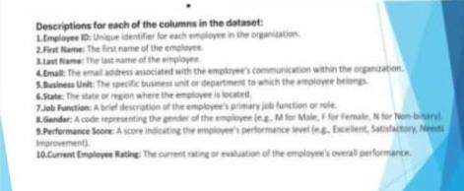
Dataset Description

Slide 9
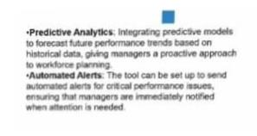

THE "WOW" IN OUR SOLUTION
3/21/2024 Annual Review
9

Slide 10
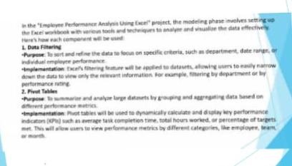
MODELLING
10

Slide 11
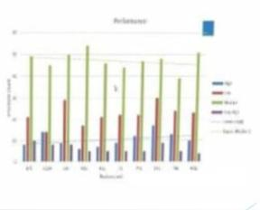
RESULTS
11

Slide 12
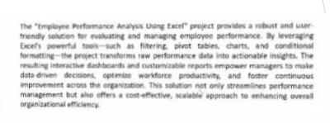
conclusion

